Slide 1


Sentiment Analysis
Donna Alex
General Assembly – DSI – San Francisco
Friday, April – 6 - 2018

Slide 2
Agenda
1. Introduction
2. Data Collection
3. Prelim study
4. Data cleaning or preparation
5. Selecting machine learning models
6. Neural Network
7. Live testing on Website

Slide 3
1. INTRODUCTION
What is sentimental analysis ?
The process of computationally identifying and categorizing opinions expressed in a piece of text whether the writer's attitude towards a particular topic, product, etc., is positive, negative, neutral … etc.
GOAL
To predict if a sentence entered by the user exhibits a positive or negative sentiment.
Initially targeted to all casual users who want to try this utility for fun.
Later on the idea can be expanded to allow automated sentiment analysis of tweets, social media posts etc..

Slide 4
2. Data Collection
Small Data :
https://archive.ics.uci.edu/ml/datasets/Sentiment+Labelled+Sentences
Corpus : 10662
Positive sentences : 5331
Negative sentences : 5331
Large Data :
I collected the data from http://cs.stanford.edu/people/alecmgo/trainingandtestdata.zip
Corpus : 1600000
Positive sentences : 800000
Negative sentences : 800000

Slide 5
3. Prelim study
I initially started of with a small data set of 2000 sentences and did the below to understand the working of sentimental analysis
Corpus
Clean the Corpus
Bag of Words
Result
(Positive or Negative)
Creating Classifier
Creating Feature Vectors

Slide 6
Corpus
Data collection
Cleaning the corpus
Removal of html, non-letters and Stop words
Bag of Words
Tokenization in NLP
Creating Feature Vectors
Transform to vectors (Count Vectorizer)
Creating Classifier
Random Forest Model
Result
Positive or Negative

Slide 7

4. Data cleaning or preparation
Initial data preparation/checking :
Shape of data.
Number of positive and Negative sentences.
Null Values
Looking into the target variable and their value

Slide 8
In-depth cleaning :
To study the data set really well and check if the below were there in sentences and I wrote a function to clean them.
HTML Decoding
@mention
URL Links
UTF-8 BOM (Byte Order Mark)
hashtag / numbers
Negations

Slide 9
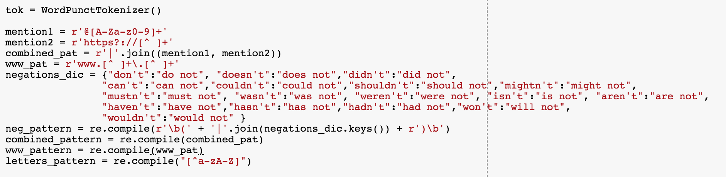
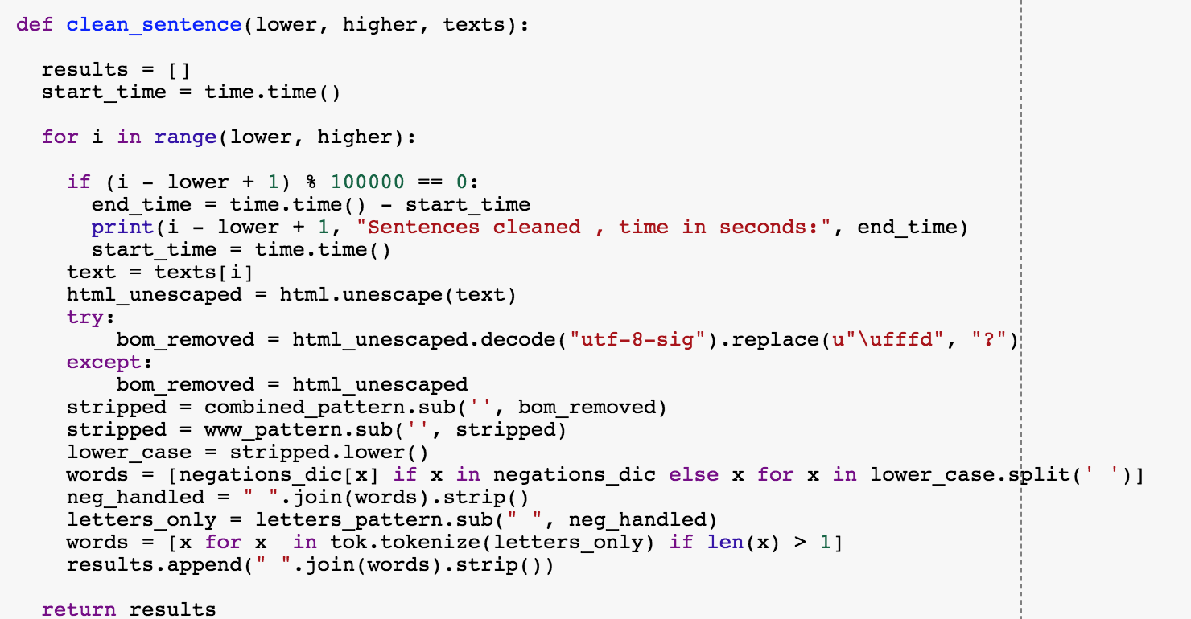

Slide 10
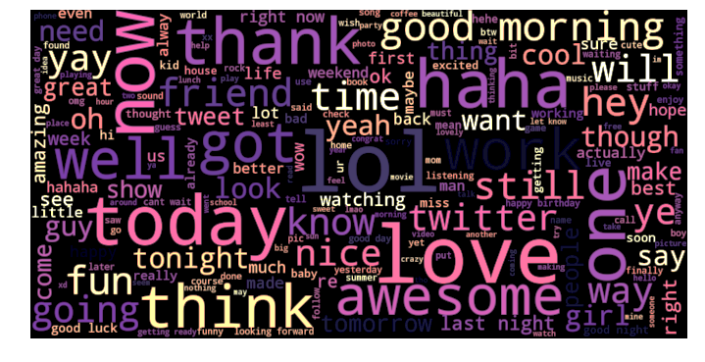
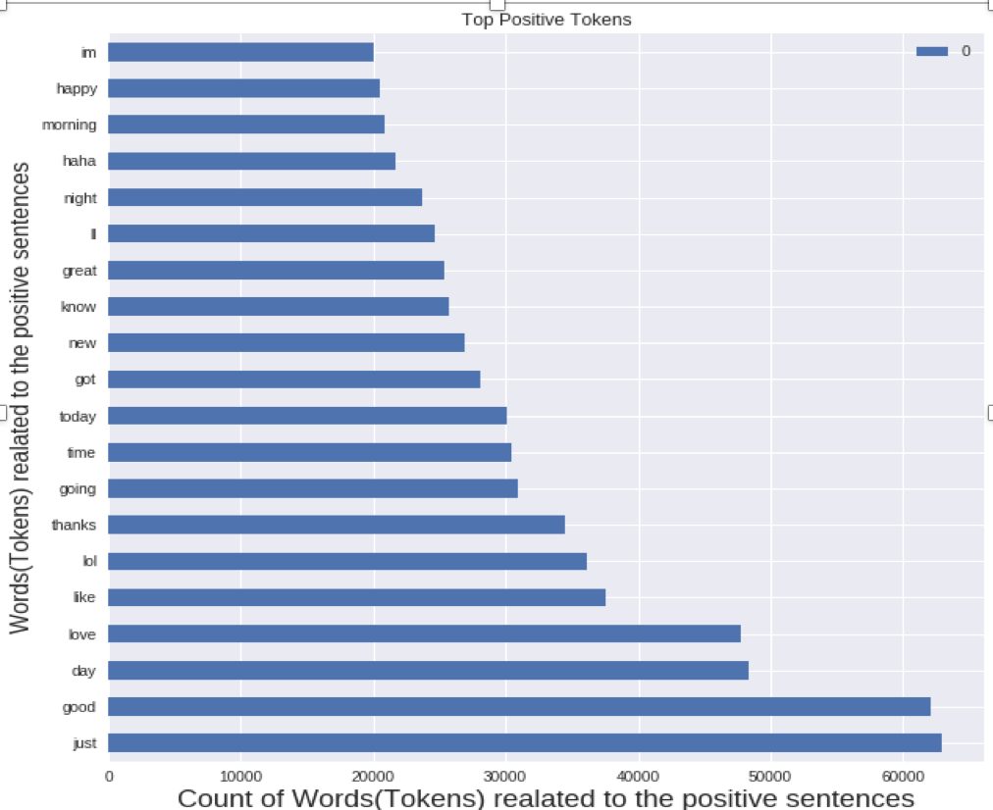
Positive sentences – words and their count

Slide 11
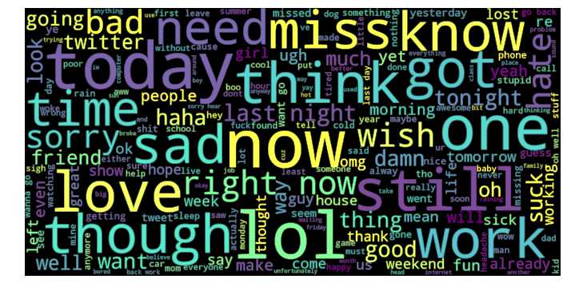
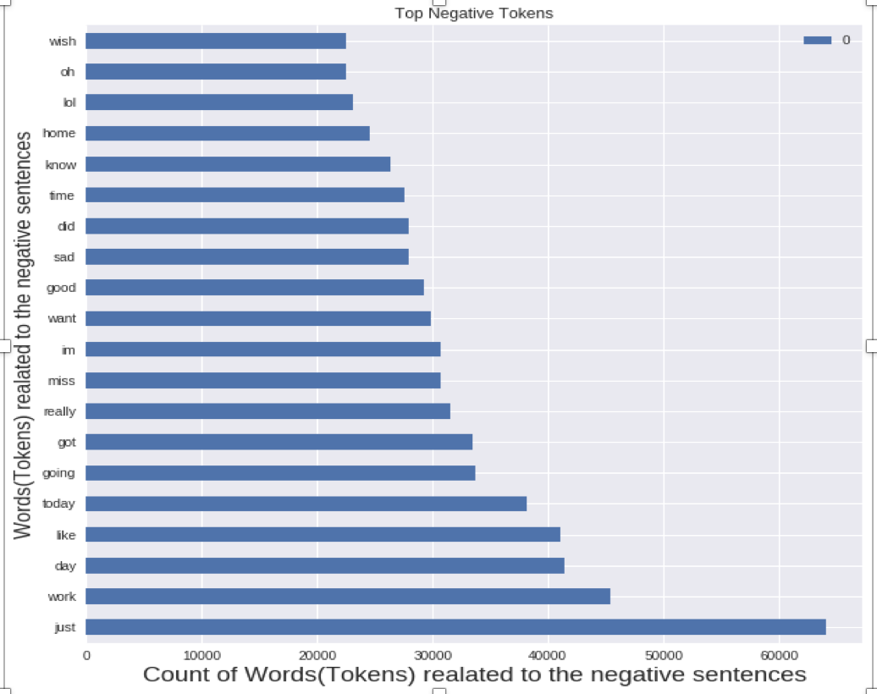
Negative sentences – words and their count

Slide 12

5. Selecting machine learning models
MODELS | VALUES
Logistic Regression | Train : 84% Test : 82%
Random Forest | Train : 98% Test : 77%
Gradient Boost | Train : 70% Test : 70%
Naive Bayes | Train : 81% Test : 80%

Slide 13


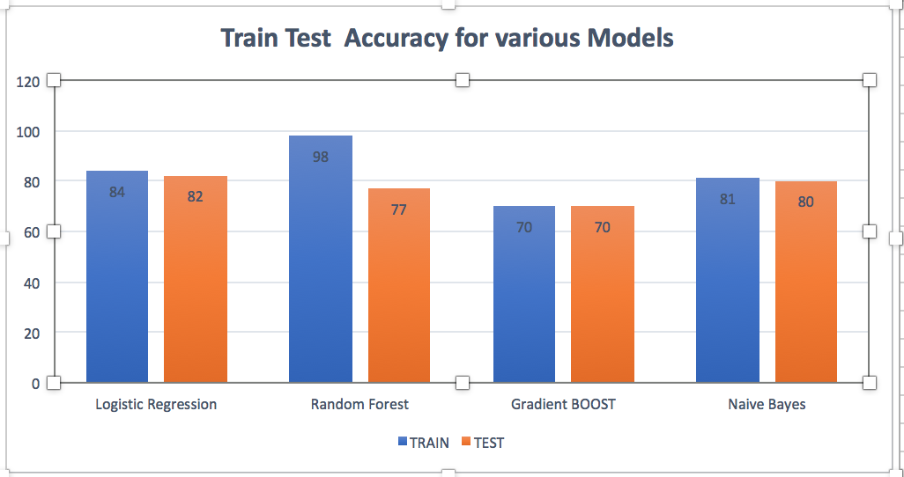



MODELS | TIME TAKEN FOR FITTING THE MODEL
LOGISTIC REGRESSION | CPU times: user 53.4 s, sys: 48 ms, total: 53.5 s
RANDOM FOREST | CPU times: user 1h 15min 28s, sys: 1.14 s, total: 1h 15min 29s
GRADIENT BOOST | CPU times: user 24min 10s, sys: 1.28 s, total: 24min 12s
NAÏVE BAYES | CPU times: user 460 ms, sys: 0 ns, total: 460 ms

Slide 14
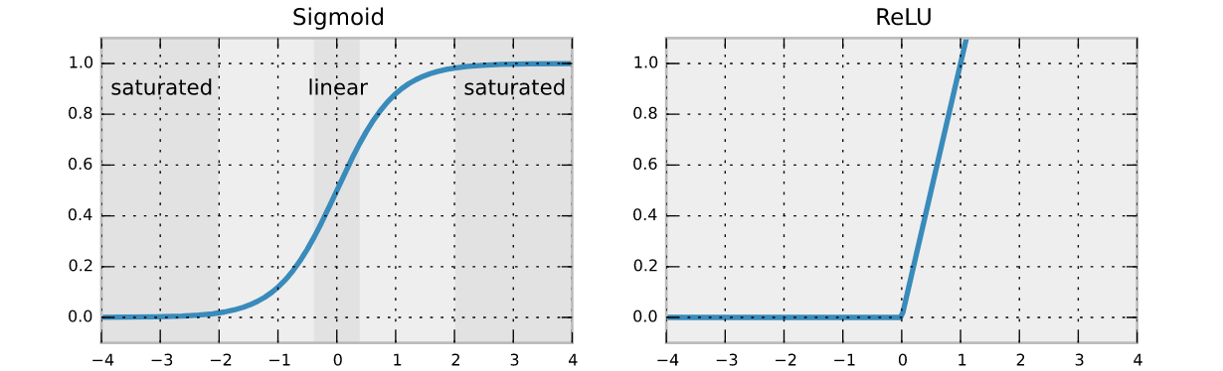
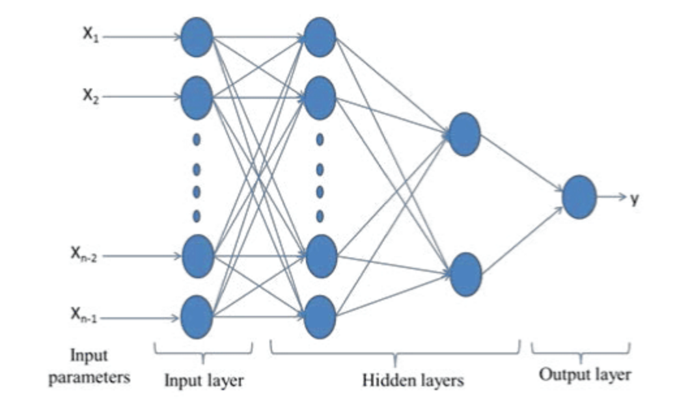
6. Neural Network
Neural networks(NN) are typically organized in layers.
Layers in NN
Communication and Processing in NN
Activation Functions in Neural Network

Slide 15
Load the data
Loading all 1600000 sentences
Null value check, Checking if there is equal no. of positive and negative sentences, Checking the data shape.
Removal of any html Now we have to define a data cleaning function that will handle the following HTML, @mention, hashtag / numbers, Negations, URL Links
Clean all the sentences
Create Feature Vectors
TfidfVectorizer(max_features=100000,ngram_range=(1,3))
tvec1.fit(x_train)
Neural Network
I input layer, 5 hidden layer, 1 output layer
RESULT
(Predictions)
Accuracy = 84%
Prediction result : Positive(prediction value > 0.5) or Negative(prediction value < 0.5)

Slide 16
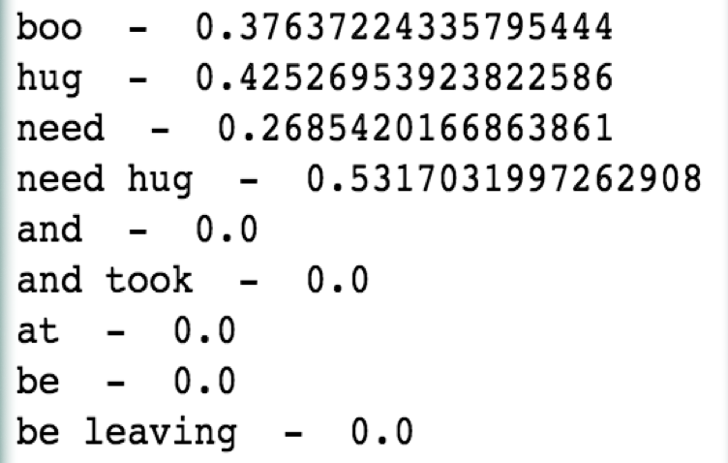
What is TFIDF ?
It weights the count of the word appropriately.
TF-IDF score of a word :
TF(word) * IDF(word)
TF(word) = No. of times the word appeared in the doc / tot. no. of words in the doc
IDF(word) = log(No. of docs/ No. of docs that contain word w)

Slide 17
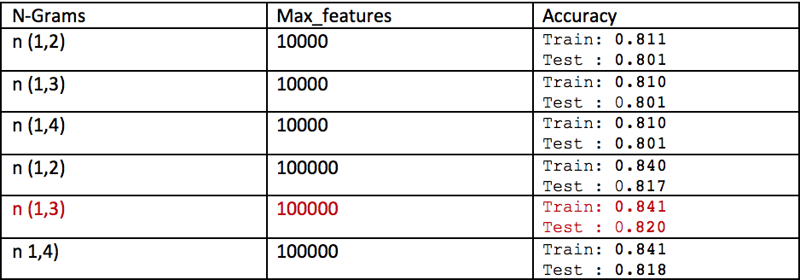
As you can see here the row marked in red had the best results , so I proceeded with
N-Grams : n(1,3)
Max_features : 100000
Accuracy : Train – 84%
Test – 82%

Slide 18
tvec1 = TfidfVectorizer(max features =100000,
ngram_range=(1, 3))
tvec1.fit(x_train)
model = Sequential()
model.add(Dense(200, activation='relu', input_dim=100000))
model.add(Dropout(0.5))
model.add(Dense(100, activation='relu'))
model.add(Dropout(0.2))
model.add(Dense(50, activation='relu'))
model.add(Dense(10, activation='relu'))
model.add(Dense(1, activation='sigmoid'))
model.compile(optimizer='adam',loss='binary_crossentropy,metrics=['accuracy'])
history = model.fit_generator(generator=batch_generator(x_train_tfidf, y_train, 32), epochs=3, validation_data=(x_validation_tfidf, y_validation), steps_per_epoch=x_train_tfidf.shape[0]/32)

Slide 19
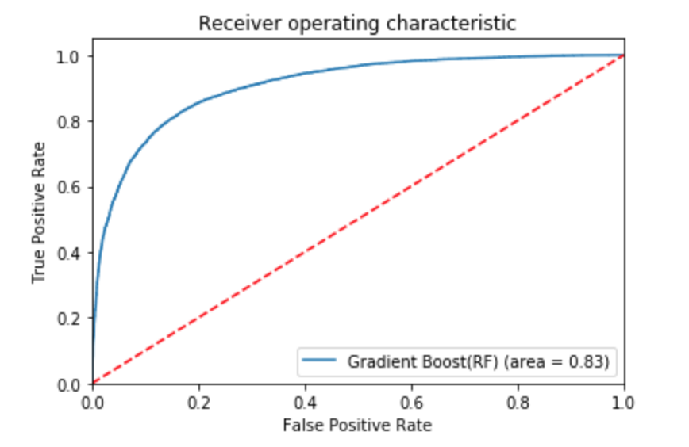
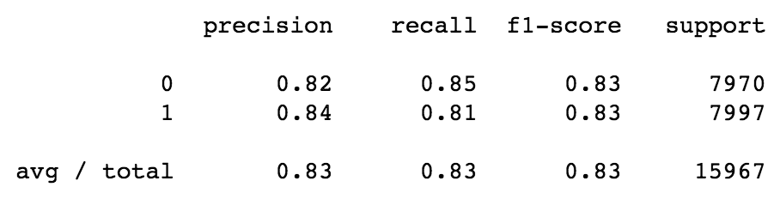
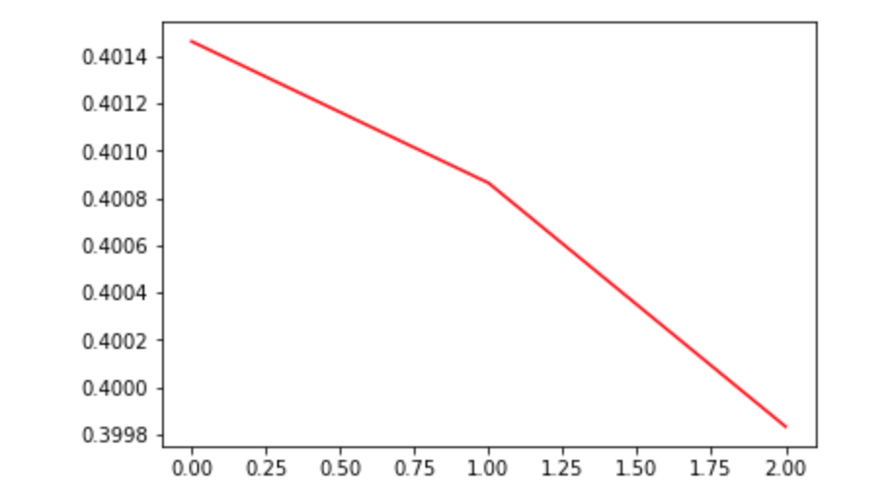
Results of Neural Network
ROC(Receiver Operating Characteristic) Curve
Classification Metrix
Validation loss curve

Slide 20
Live testing on Website
I accomplished this with the help of FLASK
What is FLASK?
Flask is a micro web framework written in Python.
Flask provides you with tools, libraries and technologies that allow you to build a web application.
This web application can be some web pages, a blog, a wiki or go as big as a web-based calendar application or a commercial website.

Slide 21
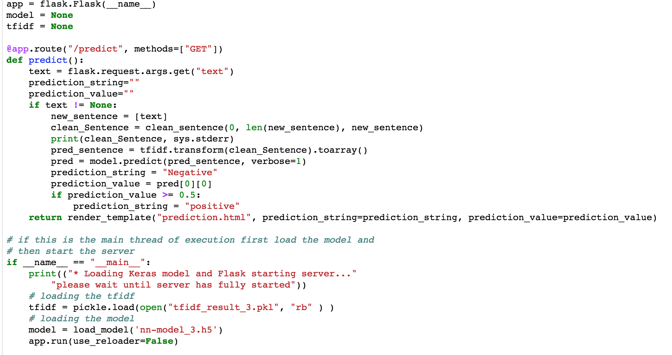
Flask code

Slide 22
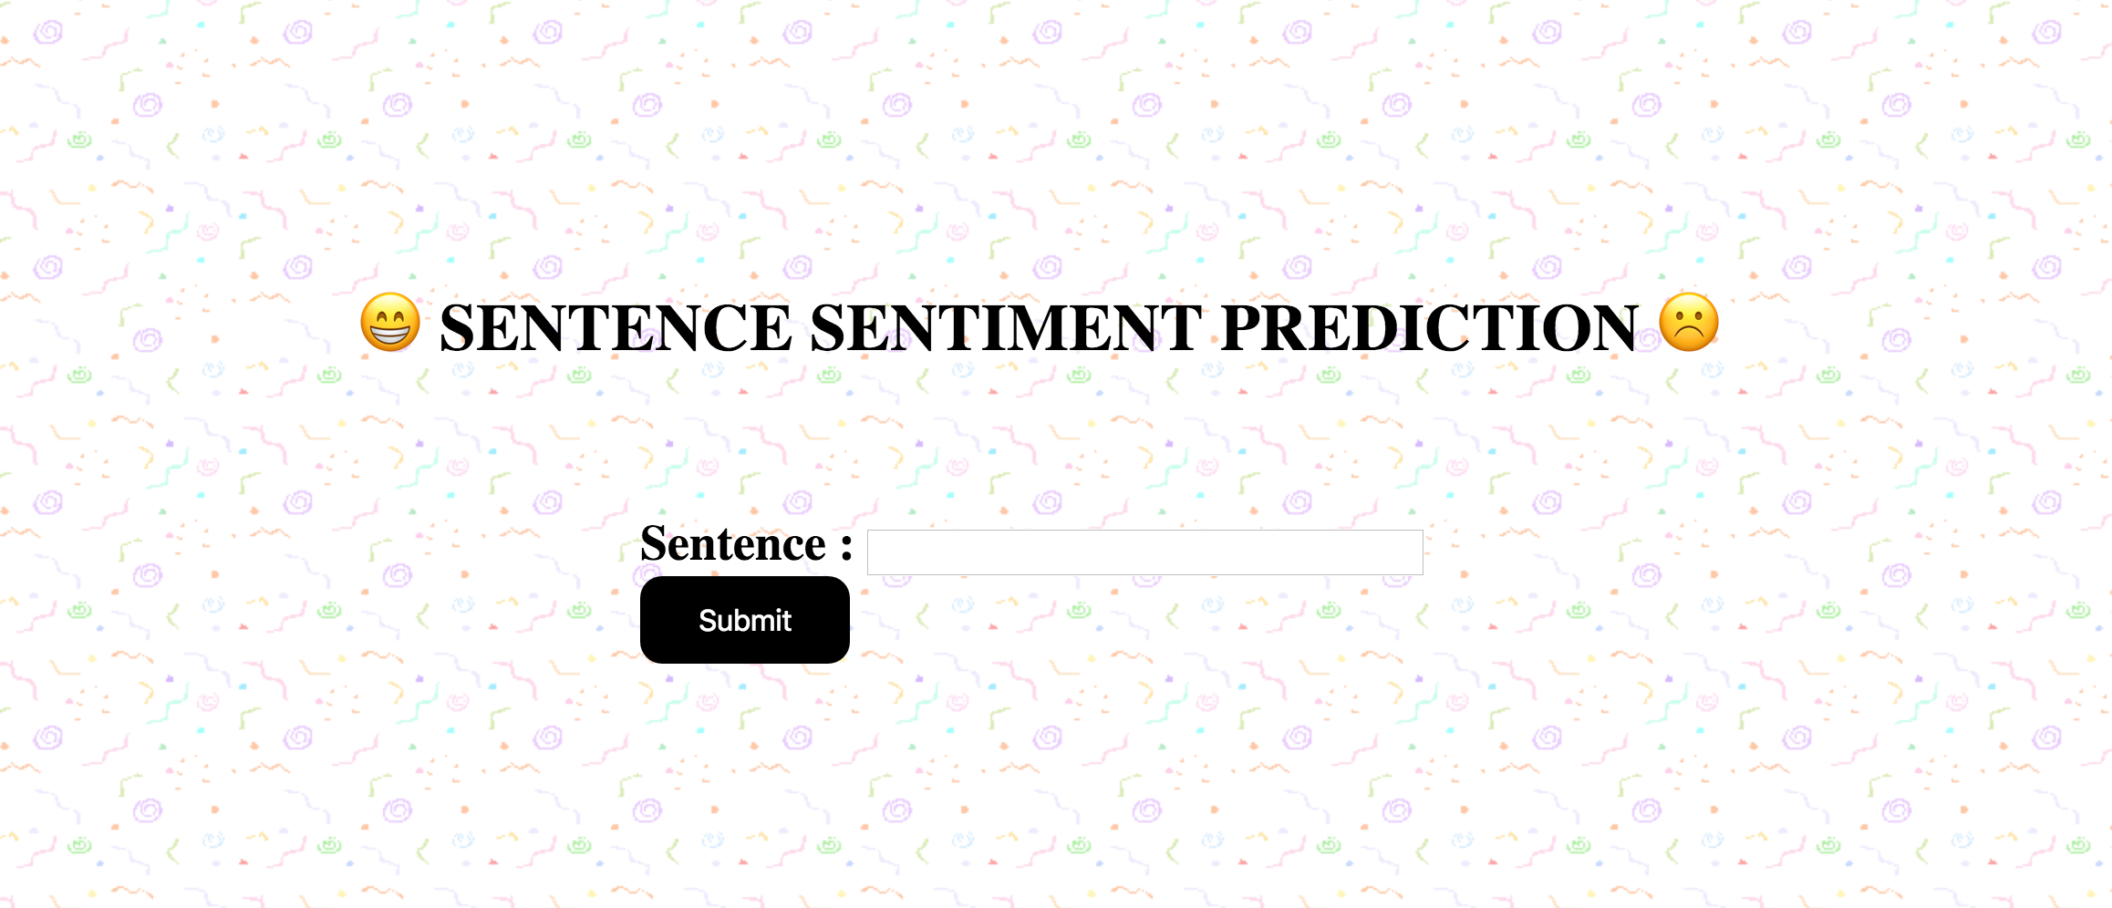
Website

Slide 23
Sentences and their prediction value
I ain’t got no money
Negative 0.09550709
I love whatever i am doin
positive 0.8527518
That’s Awesome!!......
positive 0.9294801
Can't nobody beat 'em.
Negative 0.19553101
Won't anybody hit us.
Negative 0.3599353
NOTE :
Prediction value < 0.5 is “Negative”
And
Prediction value > 0.5 is “Positive”

Slide 24


Questions ???......

Slide 25
References
https://www2.cs.duke.edu/courses/spring14/compsci290/assignments/lab02.html
https://www.datasciencebytes.com/bytes/2015/02/24/running-a-flask-app-on-aws-ec2/
https://medium.com/paper-club/paper-review-dropout-a-simple-way-to-prevent-neural-networks-from-overfitting-4f25e8f2283a
https://keras.io/models/sequential/
https://archive.ics.uci.edu/ml/datasets/Sentiment+Labelled+Sentences
https://arxiv.org/pdf/1612.01556.pdf
YouTube videos on sentimental analysis

Slide 26


